Slide 1

MWALIMU NYERERE MEMORIAL ACADEMY (MNMA – KARUME CUMPASS)
MODULE THREE
MODULE code: bat 04101
BASIC BUSINESS MATHEMATICS
Instructor : Mr. Fungwa Elias Joseph
Email: josephfungwa88@gmail.com Phone:0765-808876

Slide 2
Basic numerical concepts in business mathematics
Lesson 1

Slide 3
OBJECTIVES
After the successful discussion in class, students will be able to:
Define different types of numbers (natural, integers, prime, rational and irrational real numbers)
Distinguish between rational and irrational numbers
Perform basic mathematical operations using different types of numbers
Calculate squares, square roots, cubes and cube roots of numbers

Slide 4

What’s In A Number?
The Mysterious World of
Number Identity…

Slide 5
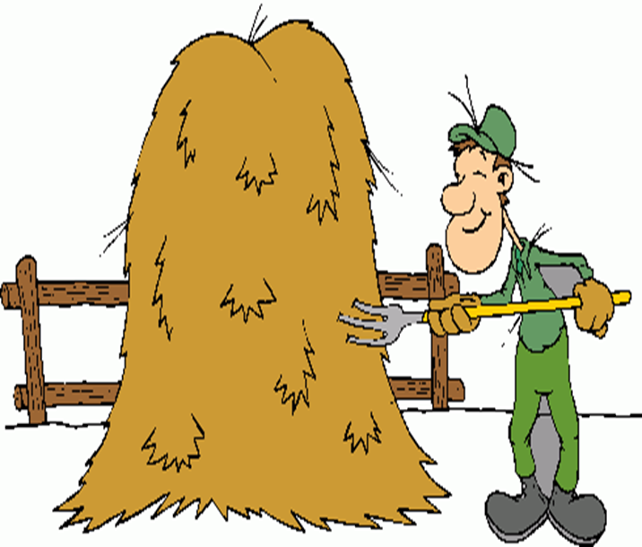
Categories of Numbers in the REAL Number System
Natural Numbers
Whole Numbers
Integers
Rational Numbers
Irrational Numbers

Slide 6



Natural Numbers
Are the counting numbers
{1, 2, 3, 4, 5, 6, 7, 8, …}

Slide 7


Whole Numbers
All of the counting numbers and zero.
{0, 1, 2, 3, 4, 5, 6, 7, …}

Slide 8
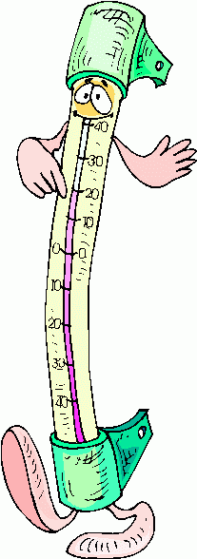
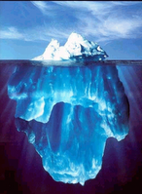
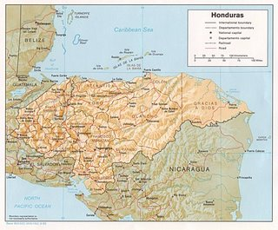
Integers
Are all of the natural numbers, their opposites and zero.
{…, -4, -3, -2, -1, 0, 1, 2, 3, 4, …}

Slide 9

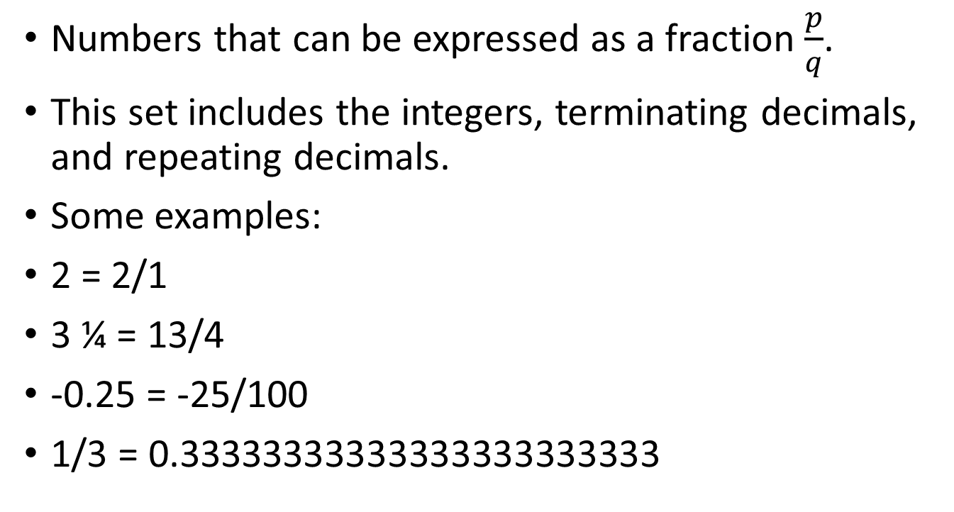
Rational Numbers
Numbers that can be expressed as a fraction $\frac{p}{q}$.
This set includes the integers, terminating decimals, and repeating decimals.
Some examples:
2 = 2/1
3 ¼ = 13/4
-0.25 = -25/100
1/3 = 0.33333333333333333333333

Slide 10
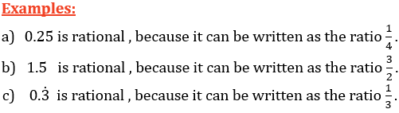

Cont…..
A Rational number(ℚ) is a number that can be written as a ratio of two integers $\frac{p}{q}$ , where p, q $∈$ ℤ & q≠ 0.
A Rational number will have a decimal expansion that is terminating or recurring.

Slide 11

Irrational Numbers
Numbers that CANNOT be expressed as a fraction of integers.
In decimal form, they are the numbers that go on forever without a repeating pattern.
Some examples:
√2 = 1.4142…
π = 3.1415…
45.9492…

Slide 12
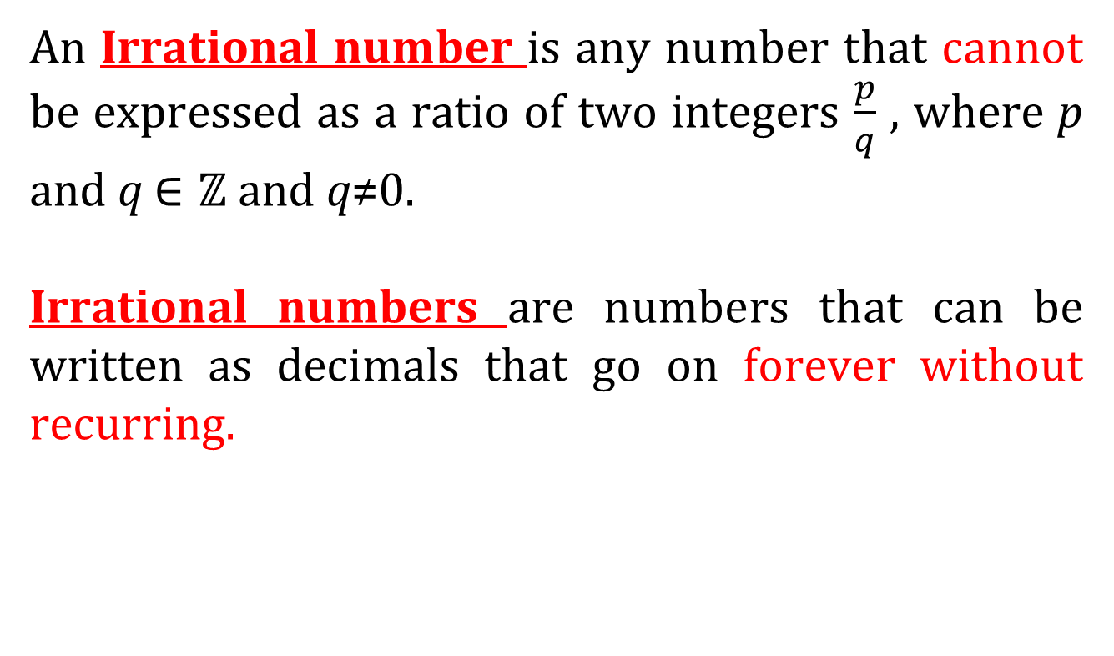
Cont…..
An Irrational number is any number that cannot be expressed as a ratio of two integers $\frac{p}{q}$ , where p and q $∈\text{ℤ}$and q≠0.
Irrational numbers are numbers that can be written as decimals that go on forever without recurring.

Slide 13
Venn Diagram of REAL Number System
Rational Numbers
Integers
Whole
Natural
Irrational Numbers

Slide 14
Quiz: Working in Pairs- Discuss question
Give me examples of natural numbers.
Give me an example of something that is not a natural number
Is “0” a natural number ? What is the smallest natural number?
How many rational numbers are there between 0 and 1?

Slide 15
Consider whether the following statements are True or False?
Every integer is a natural number
Every natural number is a rational number
Every rational number is an integer
Every integer is a rational number
Every natural number is an integer

Slide 16
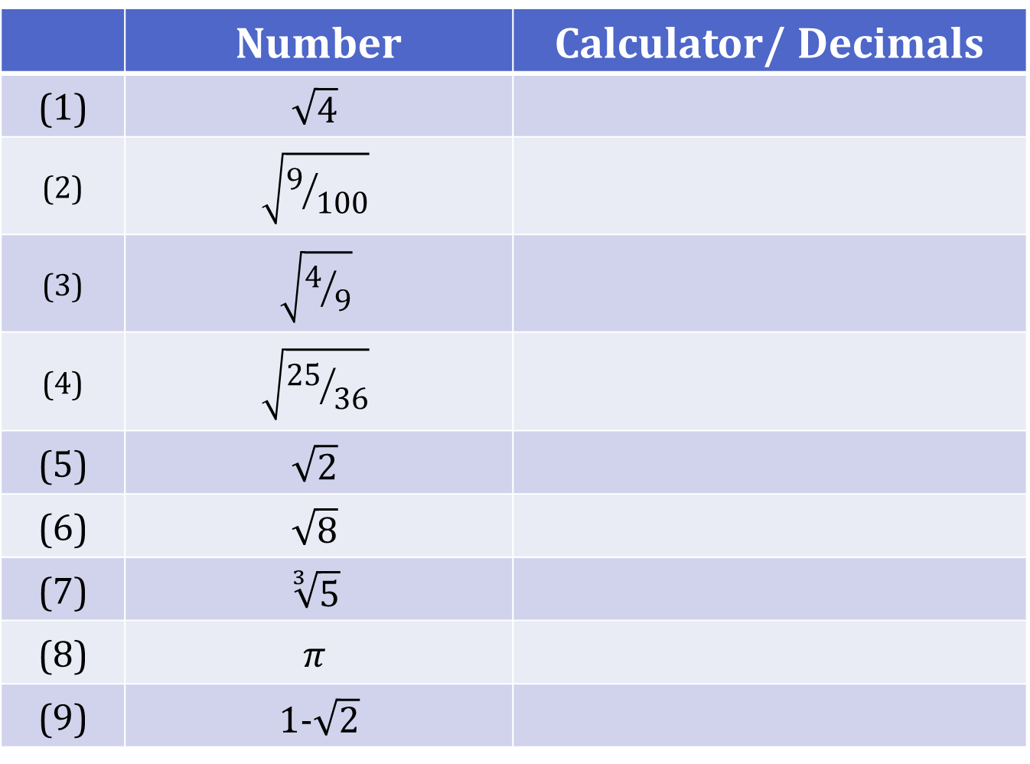
Student Activity Calculator Activity

Slide 17
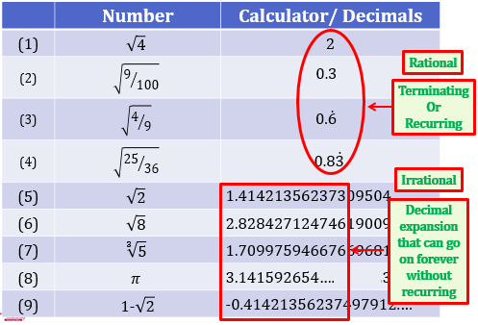
Cont……

Slide 18
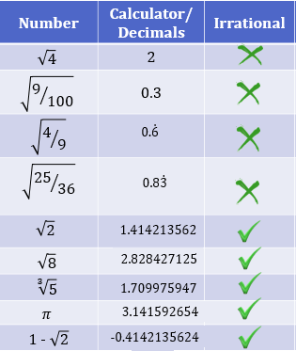
Cont…….

Slide 19
Real Number System (ℝ)
The set of Rational and Irrational numbers together make up the Real number system (ℝ).

Slide 20
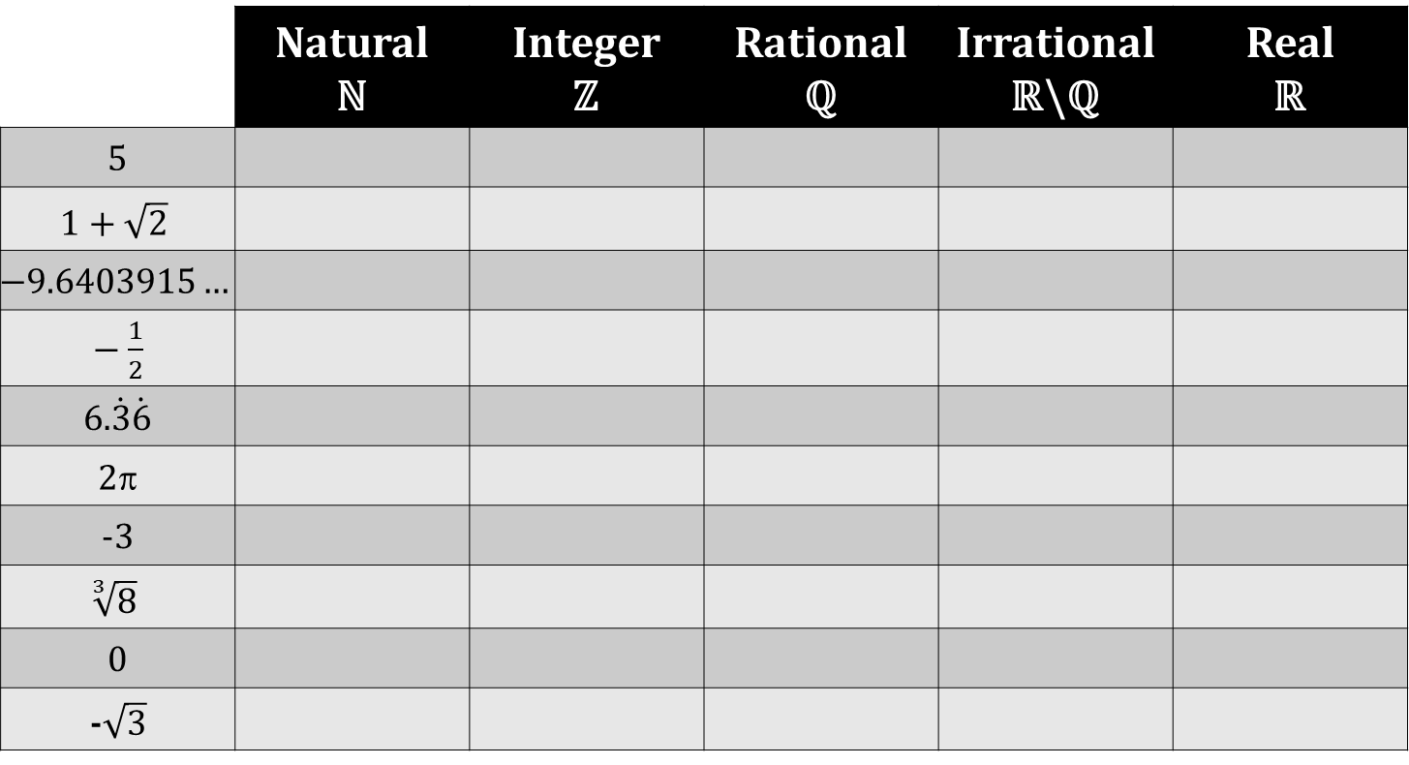
Student Activity Classify all the following numbers as natural, integer, rational, irrational or real using the table below. List all that apply.

Slide 21
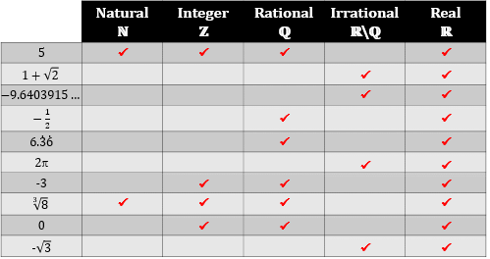
Cont……

Slide 22
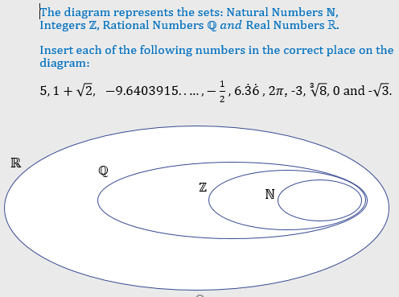

Slide 23
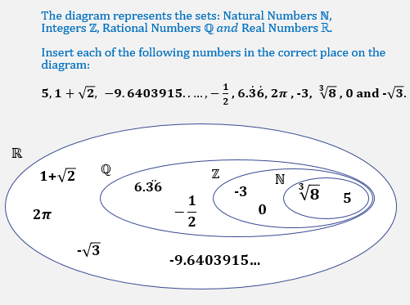

Slide 24
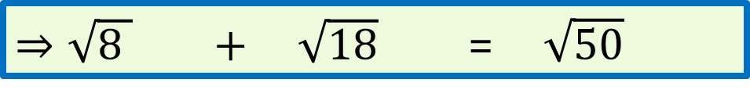
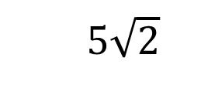



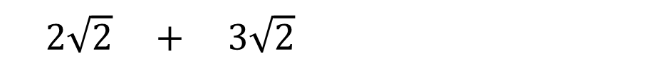

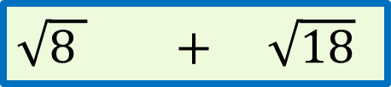

Show that$\sqrt{8 }$ $+ \sqrt{18}$ = $\sqrt{50}$without the use of a calculator.
$\sqrt{8 }$ $+ \sqrt{18}$
$$\sqrt{50 }$$
$$\sqrt{4 x 2} + \sqrt{9 x 2}$$
$$\sqrt{25 x 2}$$
$$\sqrt{4 }\sqrt{2 } + \sqrt{9} \sqrt{2}$$
$$\sqrt{25 }\sqrt{2}$$
2$\sqrt{2} +$ 3$\sqrt{2}$
$5\sqrt{2}$
5$\sqrt{2}$
$⇒\sqrt{8 }$ $+ \sqrt{18}$ = $\sqrt{50}$

Slide 25
Squares & Square Roots

Slide 26
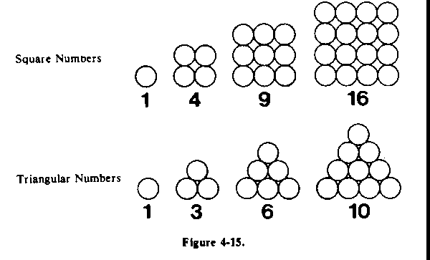
Square Number
Also called a “perfect square”
A number that is the square of a whole number
Can be represented by arranging objects in a square.

Slide 27
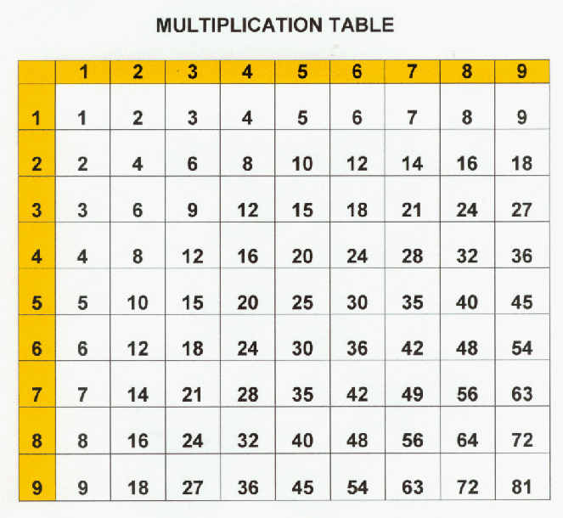
Square Numbers

Slide 28
Square Numbers
1 x 1 = 1
2 x 2 = 4
3 x 3 = 9
4 x 4 = 16

Slide 29
Square Numbers
1 x 1 = 1
2 x 2 = 4
3 x 3 = 9
4 x 4 = 16
Activity:
Calculate the perfect
squares up to 15²…

Slide 30
Square Numbers
1 x 1 = 1
2 x 2 = 4
3 x 3 = 9
4 x 4 = 16
5 x 5 = 25
6 x 6 = 36
7 x 7 = 49
8 x 8 = 64
9 x 9 = 81
10 x 10 = 100
11 x 11 = 121
12 x 12 = 144
13 x 13 = 169
14 x 14 = 196
15 x 15 = 225

Slide 31
Activity: Identify the following numbers as perfect squares or not.
16
15
146
300
324
729

Slide 32
Activity: Identify the following numbers as perfect squares or not.
16 = 4 x 4
15
146
300
324 = 18 x 18
729 = 27 x 27

Slide 33
Square Numbers
One property of a perfect square is that it can be represented by a square array.
Each small square in the array shown has a side length of 1cm.
The large square has a side length of 4 cm.
4cm
4cm
16 cm²

Slide 34
Square Numbers
The large square has an area of 4cm x 4cm = 16 cm².
The number 4 is called the square root of 16.
We write: 4 = 16
4cm
4cm
16 cm²

Slide 35
Square Root
A number which, when multiplied by itself, results in another number.
Ex: 5 is the square root of 25.
5 = 25

Slide 36
Finding Square Roots
We can use the following strategy to find a square root of a large number.
4 x 9 = 4 x 9
36 = 2 x 3
6 = 6

Slide 37
Finding Square Roots
4 x 9 = 4 9
36 = 2 x 3
6 = 6
We can factor large perfect squares into smaller perfect squares to simplify.

Slide 38
Finding Square Roots
Activity: Find the square root of 256
256
= 4 x
64
= 2 x 8
= 16

Slide 39
Squares & Square Roots
Estimating Square Root

Slide 40
Estimating Square Roots
25 = ?

Slide 41
Estimating Square Roots
25 = 5

Slide 42
Estimating Square Roots
49 = ?

Slide 43
Estimating Square Roots
49 = 7

Slide 44
Estimating Square Roots
27 = ?

Slide 45
Estimating Square Roots
27 = ?
Since 27 is not a perfect square, we
have to use another method to
calculate it’s square root.

Slide 46
Estimating Square Roots
Not all numbers are perfect squares.
Not every number has an Integer for a square root.
We have to estimate square roots for numbers between perfect squares.

Slide 47
Estimating Square Roots
To calculate the square root of a non-perfect square
1. Place the values of the adjacent perfect squares on a number line.
2. Interpolate between the points to estimate to the nearest tenth.

Slide 48
Estimating Square Roots
Example: 27
What are the perfect squares on each side of 27?
25
30
35
36

Slide 49
Estimating Square Roots
Example: 27
half
5
6
25
30
35
36
27
Estimate 27 = 5.2

Slide 50
Estimating Square Roots
Example: 27
Estimate: 27 = 5.2
Check: (5.2) (5.2) = 27.04

Slide 51
One of the great mathematical geniuses, S ramanujan had a visit of prof G H hardy. He came with a taxi whose number is 1729 .he described the number as a dull number. Ramanujan quickly pointed that 1729 was indeed interesting. He said it was the smallest number that can be expressed as the sum of two cubes in two different ways.
1729 = 1728+1=12³ + 1³
1729 = 1000+729=10³ + 9³

Slide 52
Cube Roots
The index of a cube root is always 3.
The cube root of 64 is written as .

Slide 53
What does cube root mean?
The cube root of a number is…
…the value when multiplied by itself three times gives the original number.

Slide 54
Cube Root Vocabulary
radical sign
index
radicand

Slide 55
Perfect Cubes
If a number is a perfect cube, then you can find its exact cube root.
A perfect cube is a number that can be written as the cube (raised to third power) of another number.
***Note…a cube root can be solved with a negative on the inside of the root symbol

Slide 56
What are Perfect Cubes?
1³ = 1 x 1 x 1 = 1
2³ = 2 x 2 x 2 = 8
3³ = 3 x 3 x 3 = 27
4³ = 4 x 4 x 4 = 64
5³ = 5 x 5 x 5 = 125
and so on and on and on…..

Slide 57
Examples:
because
because

Slide 58
Examples:

Slide 59
Simplify Cube Roots
Not all numbers or expressions have an exact cube root as in the previous examples.
If a number is NOT a perfect cube, then you might be able to SIMPLIFY it.

Slide 60
To simplify a cube root ...
1 Write the radicand as a product of two factors, where one of the factors is a perfect cube.
2 Extract the cube root of the
factor that is a perfect cube.
3 The factors that are not perfect cubes will remain as the radicand.

Slide 61
Examples:
perfect cube
1)
2)
3)

Slide 62
Not all cube roots
can be simplified!
Example:
30 is not a perfect cube.
30 does not have a perfect cube factor.
cannot be simplified!

